Slide 1


Articulated 3D SLAM
Matt Klingensmith

Slide 2
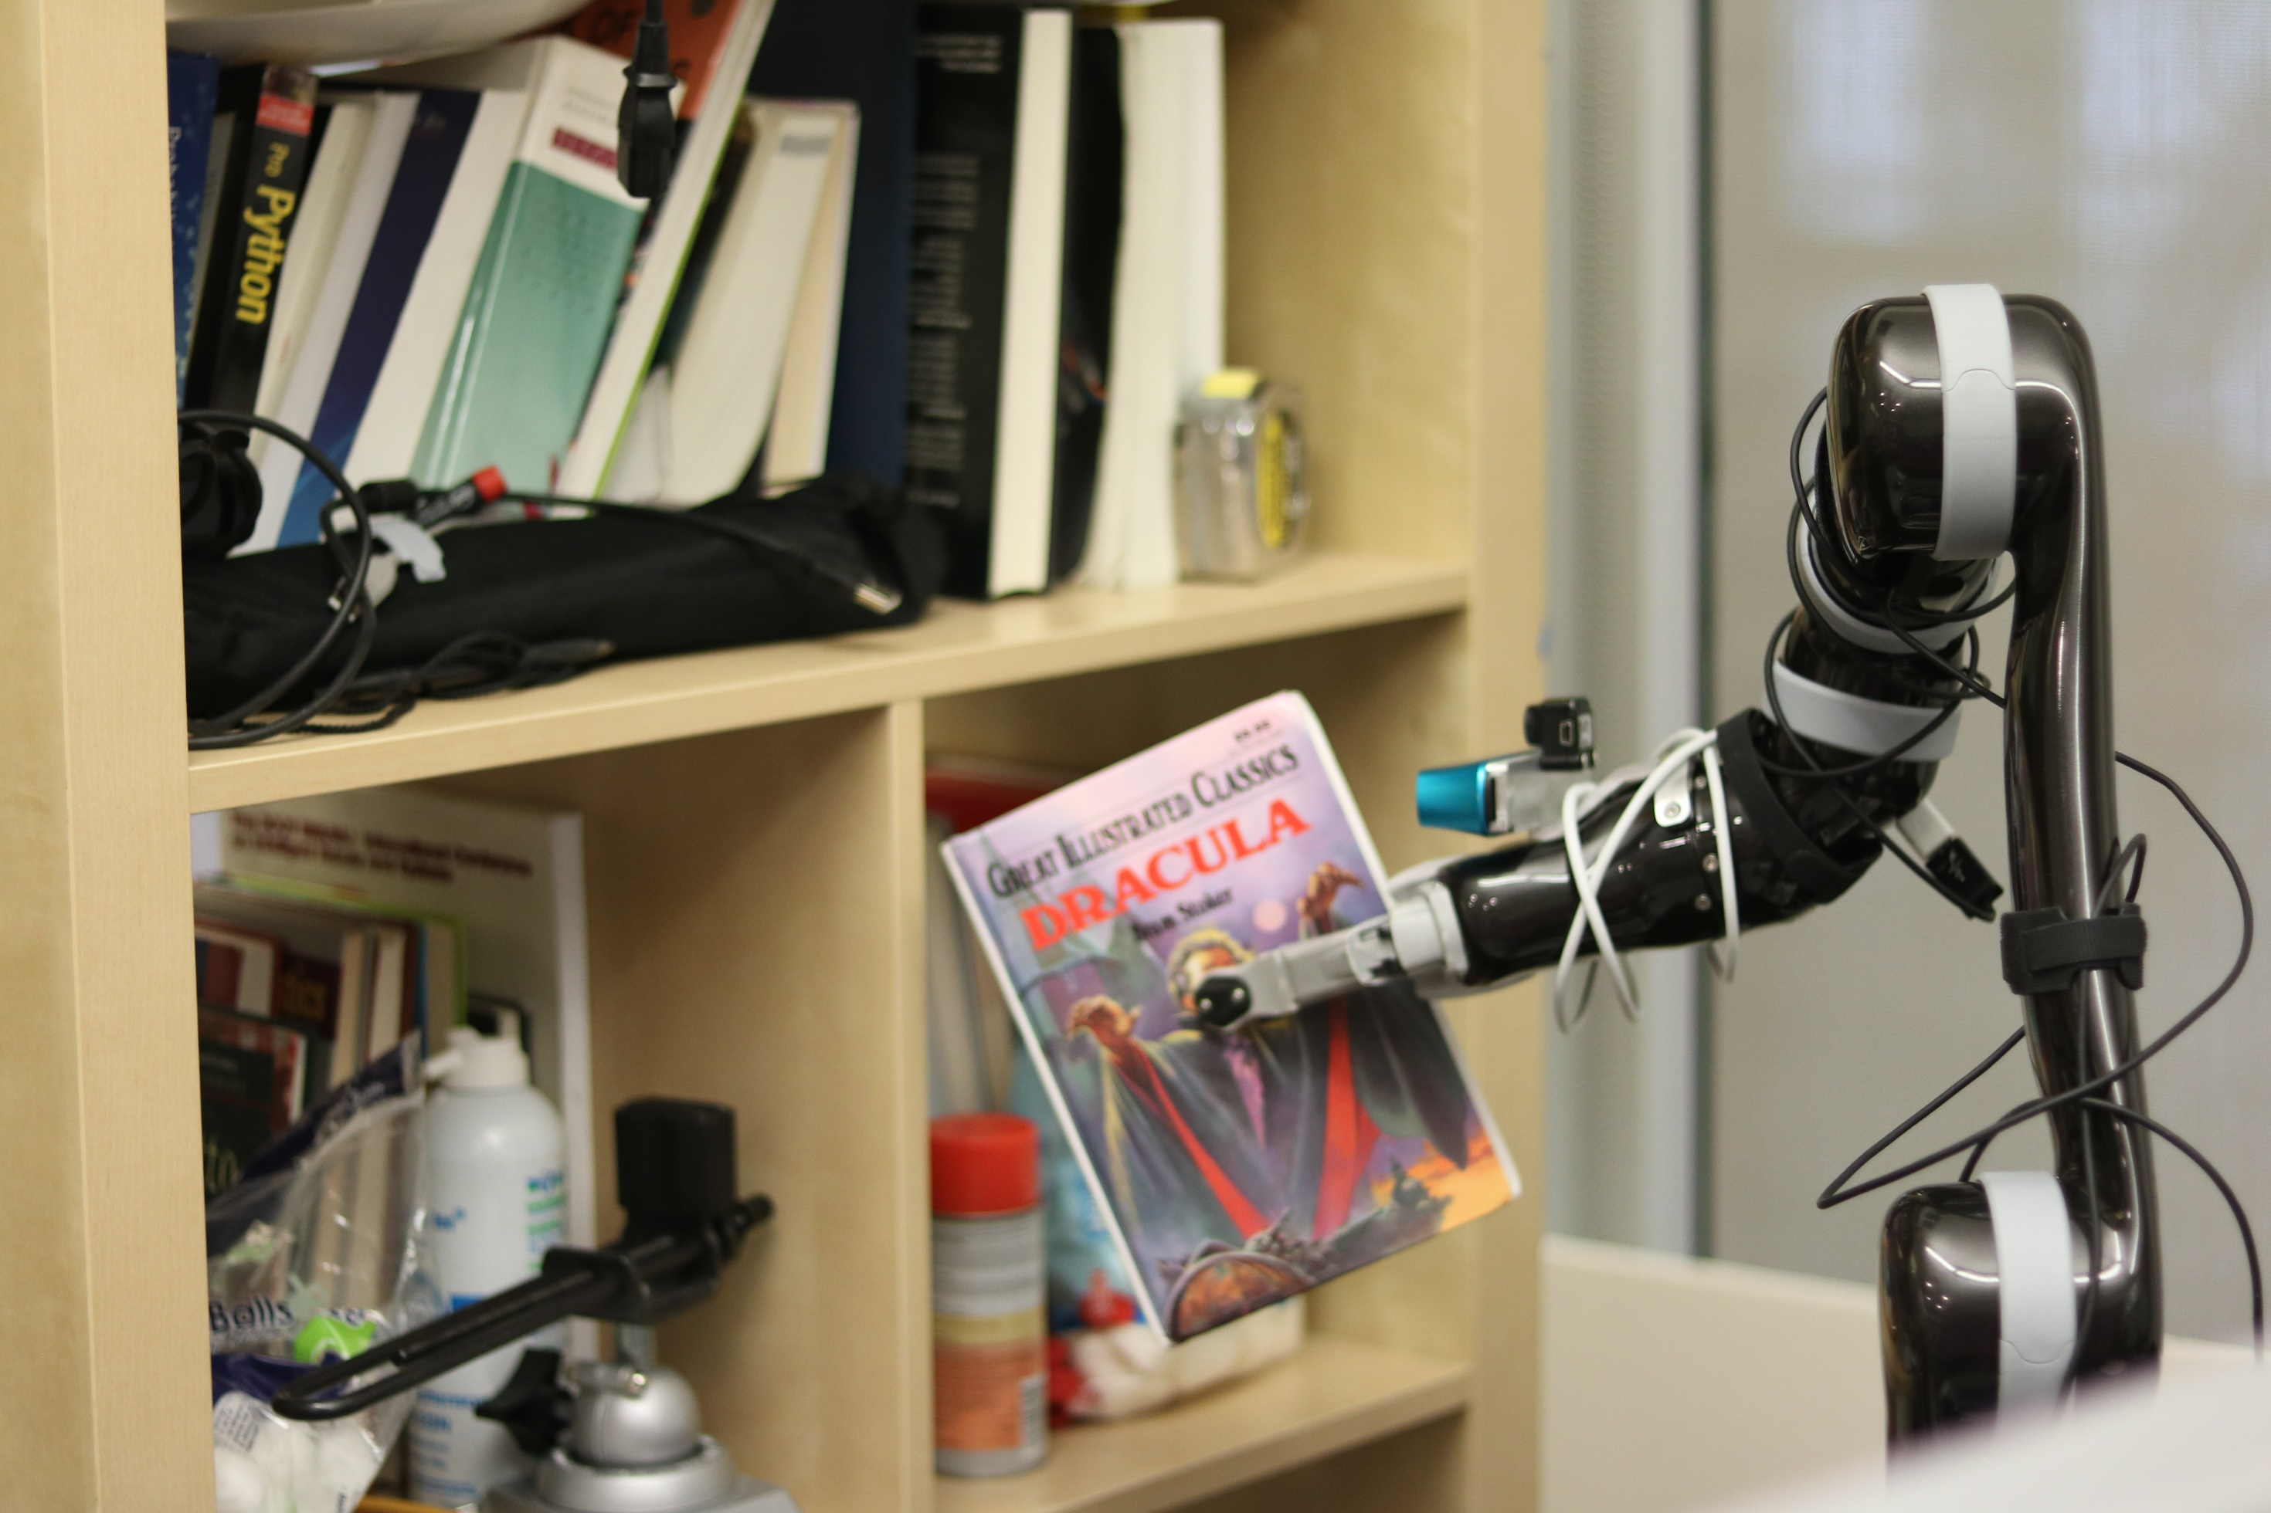

Slide 3


Slide 4
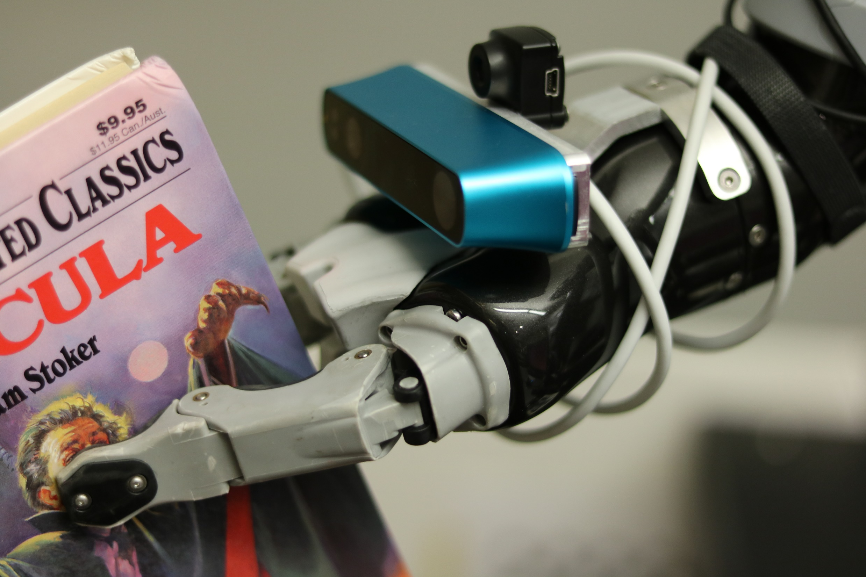

Slide 5
Color Camera
Depth Camera

Slide 7
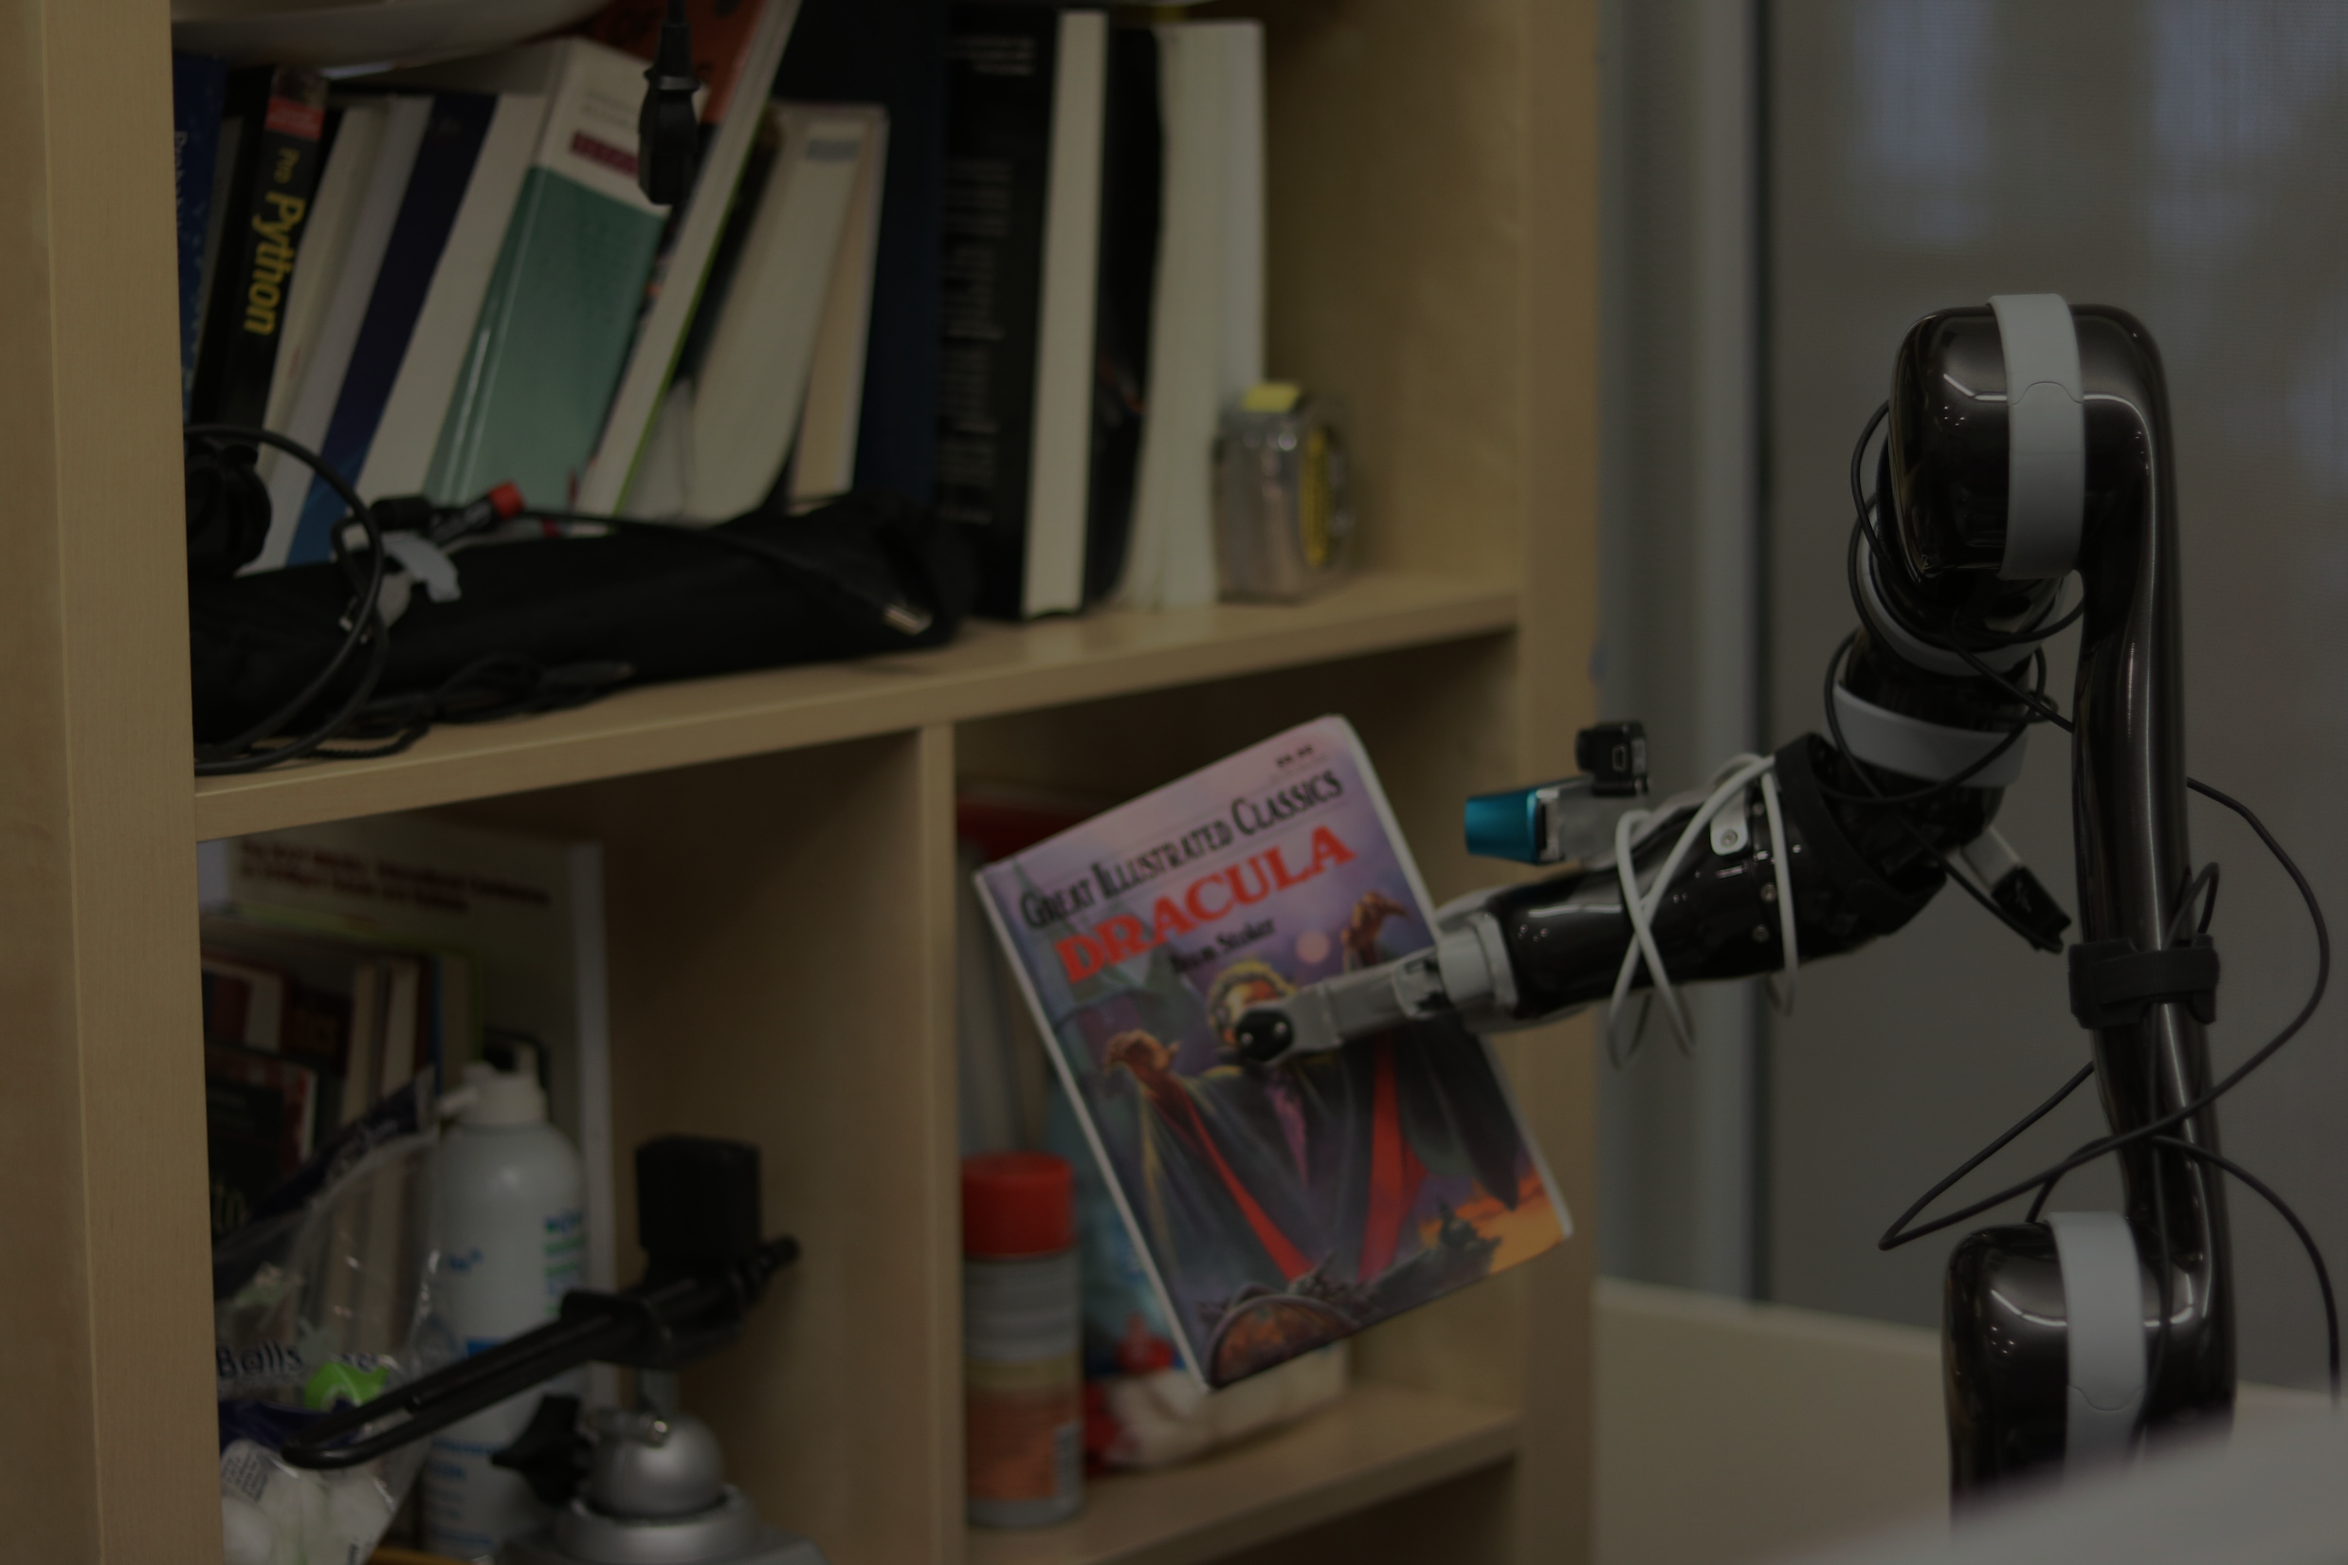

Slide 9
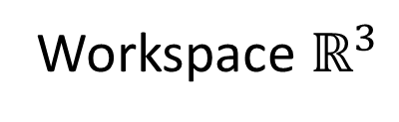
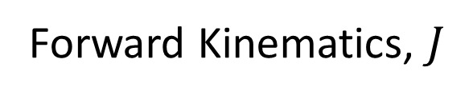
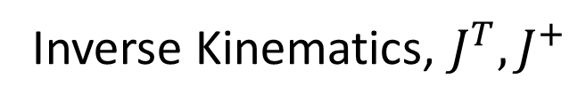
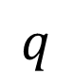
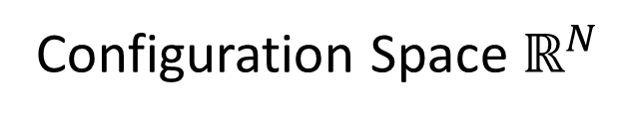
Inverse Kinematics, $J^{T},J^{+}$
$$q$$
Configuration Space $ℝ^{N}$
Workspace $ℝ^{3}$
Forward Kinematics, $J$

Slide 10
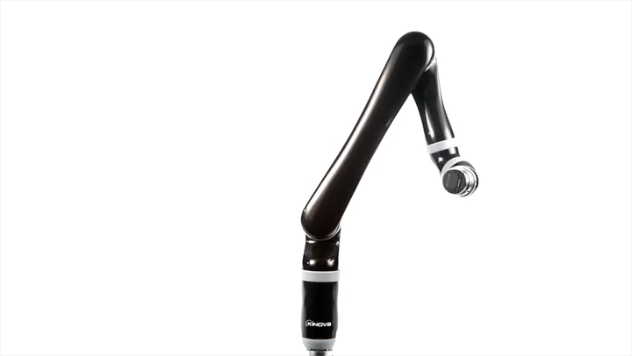
Easy problem!
Deterministic
Closed form

Slide 11
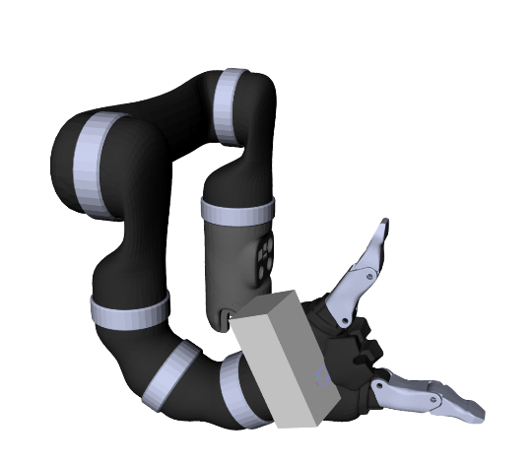
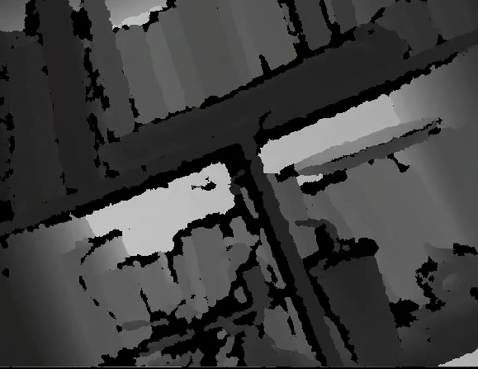
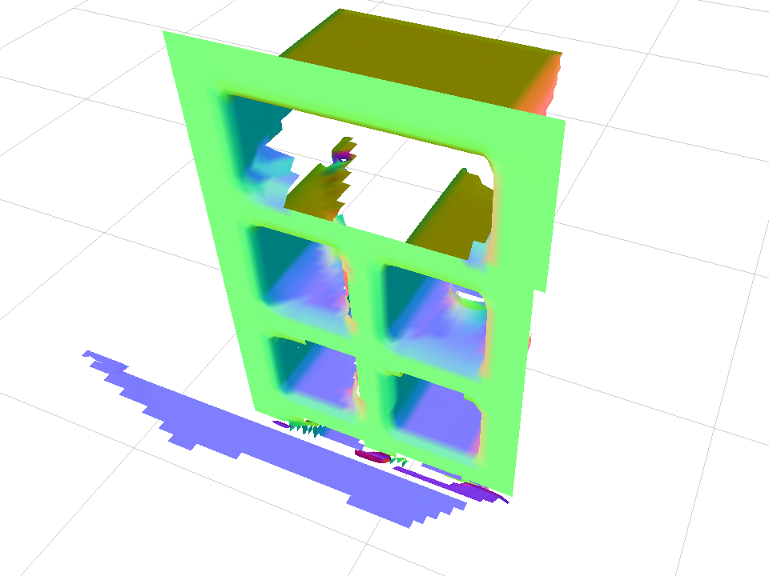
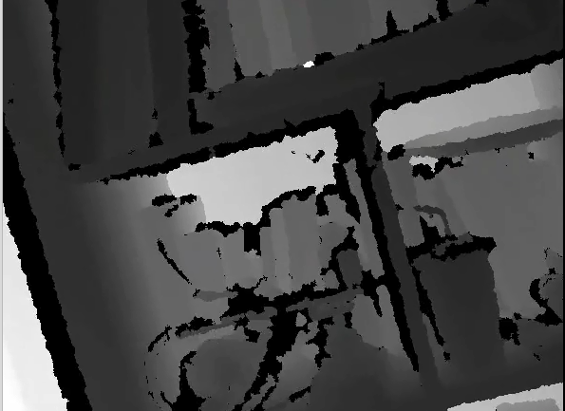
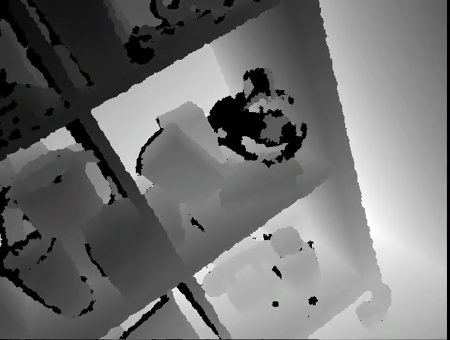
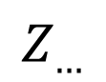
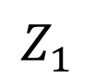
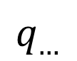
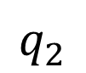
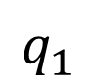
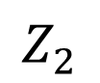
$$q_{1}$$
$$Z_{1}$$
M
$$q_{2}$$
$$Z_{2}$$
$$q_{…}$$
$$Z_{…}$$

Slide 12
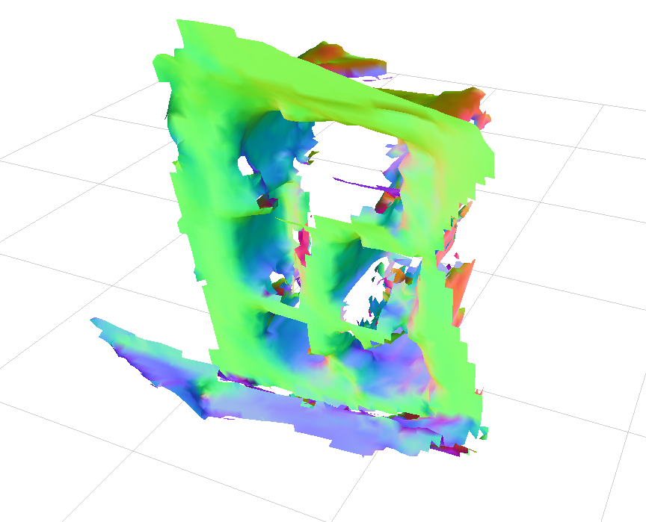

Slide 13
Two Main Error Sources
Sensor Uncertainty
Actuator Uncertainty

Slide 14
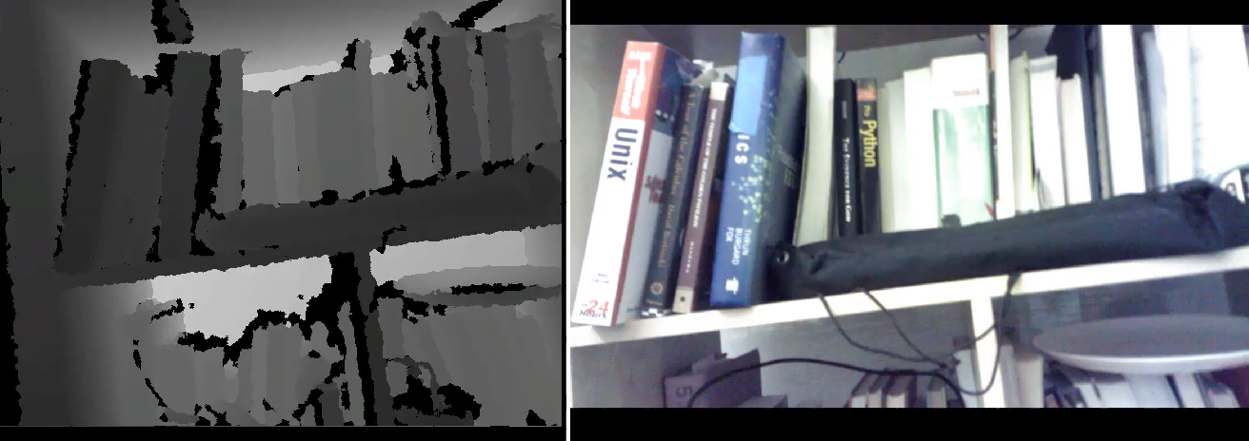
Sensor Uncertainty

Slide 15
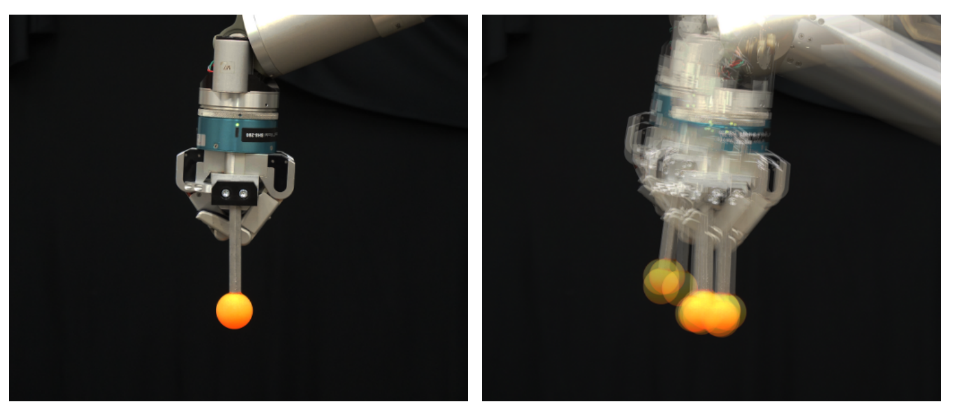
Actuator Uncertainty

Slide 16
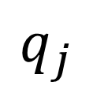
Actuator Uncertainty
Motor
Joint
$$q_{j}$$

Slide 17
Actuator Uncertainty
Mechanism
Motor
Joint
$$q_{j}$$

Slide 18
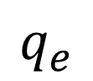
Actuator Uncertainty
Mechanism
Motor
Joint
$$q_{j}$$
Encoder
$$q_{e}$$

Slide 19
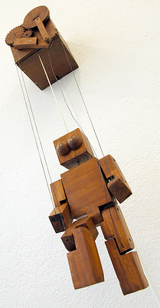
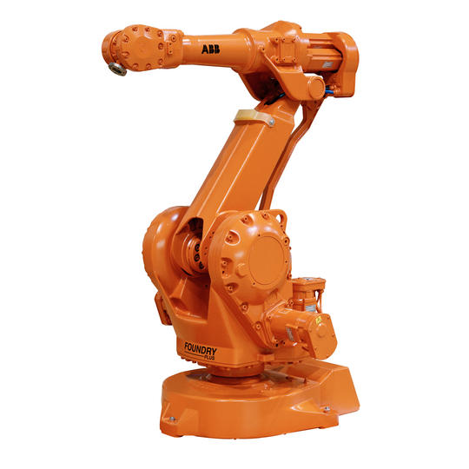
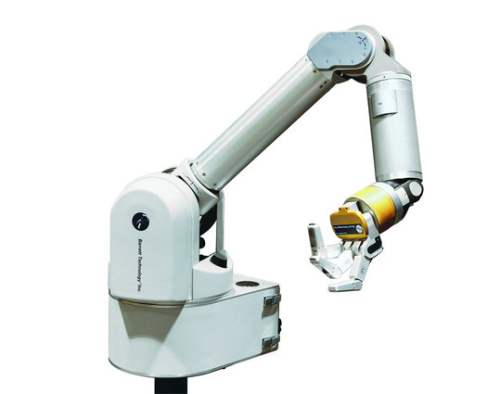
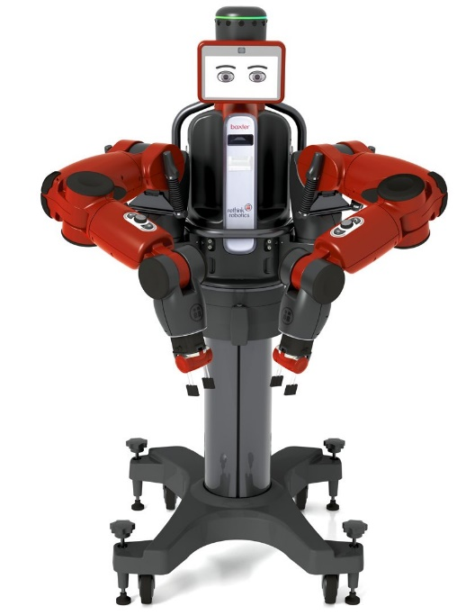
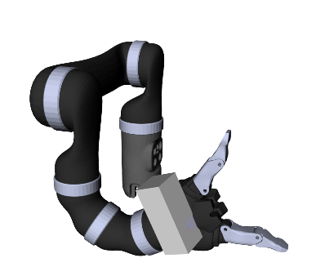
Actuator Uncertainty
More Direct
Less Direct

Slide 20

Articulated SLAM:
Given a noisy sensor and noisy actuators how can we reconstruct the world?

Slide 21
First, an easier (but related) problem.

Slide 22
Articulated Tracking

Slide 23
Main idea:
Maximize the likelihood of the robot’s configuration given sensor data.

Slide 24
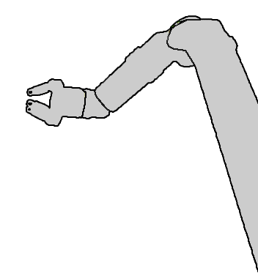
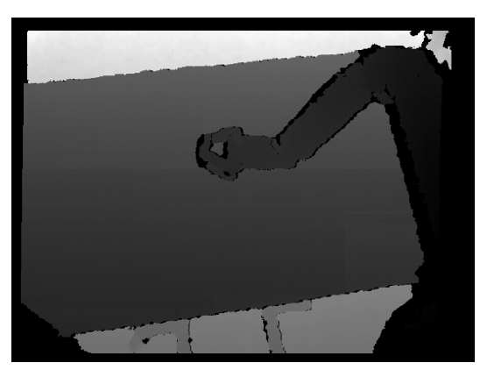
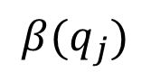
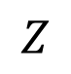
Articulated Tracking
Robot Kinematics
Sensor Data
$$Z$$
$$β(q_{j})$$

Slide 25
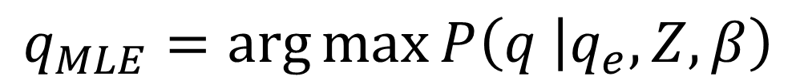
Articulated Tracking
$$q_{MLE}=\arg{\max{P\left(q | q_{e}, Z, β\right)}}$$

Slide 26
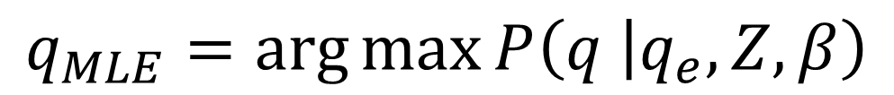
Articulated Tracking
$$q_{MLE}=\arg{\max{P\left(q | q_{e}, Z, β\right)}}$$
= …
$$=\arg{\max{\log{P(q_{e}│q)}+\log{P(Z│q, β)}}}$$
Motion Prior
Sensor Posterior

Slide 27
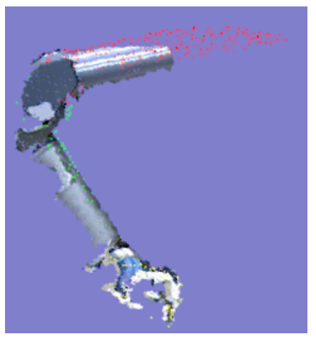

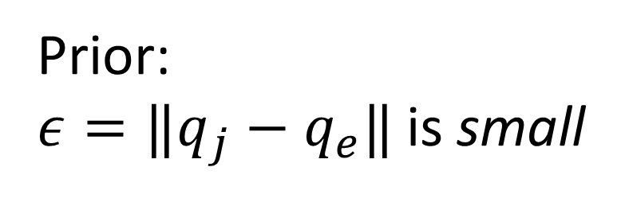
Real-time Markerless Arm Tracking (RMAT)
Prior:
$ε=‖q_{j}−q_{e}‖$ is small
Posterior:
$β\left(q_{j}\right)≈Z,$I.I.D noise
[Klingensmith ’13]

Slide 28
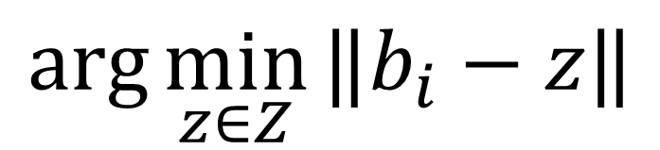
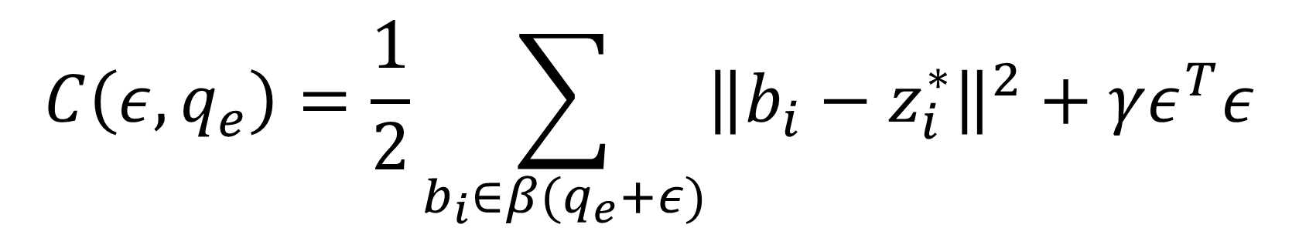
Real-time Markerless Arm Tracking (RMAT)
$$C\left(ε, q_{e}\right)=\frac{1}{2}\sum_{b_{i}∈β(q_{e}+ε)}{{\left\|b_{i}−z_{i}^{∗}\right\|}^{2}}+γε^{T}ε$$
$$\arg{\min_{z∈Z}{‖b_{i}−z‖}}$$

Slide 29
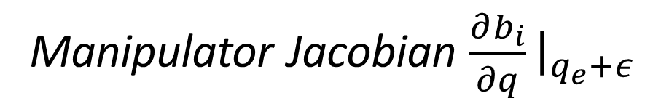
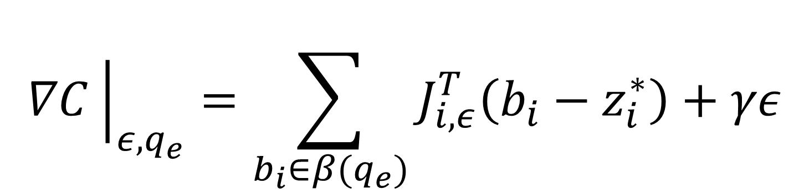
RMAT Gradient Descent
$$∇C{\left.​\right|}_{ε, q_{e}}=\sum_{b_{i}∈β(q_{e})}{J_{i, ε}^{T}\left(b_{i}−z_{i}^{∗}\right)}+γε$$
Manipulator Jacobian $\frac{∂b_{i}}{∂q}{\left.​\right|}_{q_{e}+ε}$

Slide 30
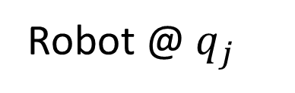
RMAT Physical Interpretation
Robot @ $q_{j}$

Slide 31
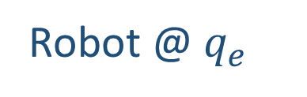
RMAT Physical Interpretation
Robot @ $q_{e}$
Robot @ $q_{j}$

Slide 32
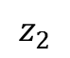
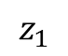
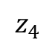
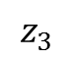
RMAT Physical Interpretation
$$z_{3}$$
$$z_{4}$$
$$z_{2}$$
$$z_{1}$$

Slide 33
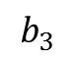
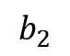


RMAT Physical Interpretation
Apply a rigid force at each point
$$b_{4}$$
$$b_{3}$$
$$b_{2}$$
$$b_{1}$$
$$z_{3}$$
$$z_{4}$$
$$z_{2}$$
$$z_{1}$$

Slide 34
RMAT Physical Interpretation
Change the configuration.

Slide 35


Slide 36

Dense Articulated Real-time Tracking (DART)
[Schmidt ’14]

Slide 37
Articulated SLAM:
Given a noisy sensor and noisy actuators how can we reconstruct the world?

Slide 38

So when the pose is unknown…
And the world is unknown…

Slide 39

Visual SLAM Problem
(Simultaneous Localization and Mapping)

Slide 40















SLAM Background
$$M$$
$$Z_{1}$$
$$Z_{t}$$
$$Z_{2}$$
$$Z_{3}$$
$$Z_{…}$$
$$H_{1}$$
$$ξ_{1}$$
$$ξ_{2}$$
$$ξ_{…}$$
$$ξ_{t−1}$$
$$H_{2}$$
$$H_{3}$$
$$H_{…}$$
$$H_{t}$$

Slide 41

SLAM Background
$$ξ^{∗}, M^{∗}=\arg{\max_{ξ, M}{P(ξ, M │Z)}}$$
Trajectory, Map
Maximum Likelihood Estimate

Slide 42
SLAM Background
3 SLAM Components
Tracking the sensor
Mapping the scene
Correcting past mistakes

Slide 43







SLAM Background
Tracking
$$ξ_{t−1}=\arg{\max_{ξ}{\text{P}\text{(}ξ }}│H_{t−1}, Z_{t}, M)$$
$$H_{t}$$
$$H_{t−1}$$
$$ξ_{t−1}$$
$$Z_{t}$$
$$Z_{t−1}$$
$$M$$

Slide 44




SLAM Background
Mapping
$$M_{t}=\arg{\max_{M}{P(M │Z_{t}, H_{t}, M_{t−1}) }}$$
$$H_{t}$$
$$Z_{t}$$
$$M_{t−1}$$

Slide 45

SLAM Background
Mapping
$$M_{t}=\arg{\max_{M}{P(M │Z_{t}, H_{t}, M_{t−1}) }}$$
$$H_{t}$$
$$Z_{t}$$
$$M_{t}$$

Slide 46

SLAM Background
Pose Graph

Slide 47
SLAM Background
Pose Graph

Slide 48
SLAM Background
Pose Graph

Slide 49
Articulated SLAM

Slide 50





Visual SLAM Problem
Articulated SLAM Problem
vs.
Camera Poses $H∈SE(3)$
Robot Configurations $q∈ℝ^{N}$
Motions $ξ∈SE(3)$
Motions$Δq∈ℝ^{N}$
Jacobians on Lie Manifold
Jacobians in $ℝ^{6×N}$
?
Weak motion prior
Strong motion prior

Slide 51
Why configuration space?

Slide 52



Why configuration space?

Slide 53
Latitude + longitude =
Complete description of state

Slide 54
Configuration of robot =
Complete description of state

Slide 55

Let’s derive articulated Kinect Fusion!
[Izadi ’11]

Slide 56










Kinect Fusion
$$H_{…}$$
$$ξ_{t−1}$$
$$H_{1}$$
$$ξ_{1}$$
$$H_{t}$$
$$Z_{t}$$
$$Z_{…}$$
$$Φ>0$$
$$Z_{1}$$
$$Φ<0$$
[Izadi ’11]

Slide 57







Kinect Fusion Tracking
$$Φ$$
$$z_{1}$$
Depth $z$
$$z_{2}$$
$$Φ\left(z_{i}\right)≈0$$
$$∇Φ\left(z_{i}\right)≈n_{i}$$
$$z_{K}$$
Normals $n$
[Izadi ’11]

Slide 58





Kinect Fusion Tracking
$$H_{t}≈\arg{\min_{H}{\sum_{i}{{\left[Φ\left(z_{i}\right) ∇Φ\left(z_{i}\right)∙n_{i}\right]}^{2}}}}$$
$$Φ$$
$$z_{1}$$
$$z_{2}$$
“Point to plane ICP”
$$z_{K}$$
[Izadi ’11]

Slide 59
Kinect Fusion Mapping
[Curless ’96]

Slide 60

Kinect Fusion Mapping
[Curless ’96]

Slide 61


Kinect Fusion Mapping
$$n_{i}$$
$$z_{i}$$
[Curless ’96]

Slide 62


Kinect Fusion Mapping
$$Φ\left(z_{i}+r_{i}t\right)≈−tn_{i}∙z_{i}$$
Truncated Signed Distance Field
[Curless ’96]

Slide 63

Kinect Fusion Mapping
Average results
[Curless ’96]

Slide 64
Lifting Kinect Fusion into the articulated domain.

Slide 65

State: $q∈ℝ^{N}$
Tracking: regularized configuration space ICP
Mapping: Truncated Signed Distance Field

Slide 66









Configuration-space ICP
$$z_{1}$$
$$z_{2}$$
$$z_{…}$$
$$z_{k}$$
$$Φ<0$$
$$Φ>0$$
$$C\left(ε, q_{e}\right)=\frac{1}{2}\sum_{z_{i}}{Φ{\left(z_{i}\right)}^{2}}+γε^{T}ε$$
$$Φ=0$$

Slide 67





Configuration-space ICP
$$Φ\left(z_{1}\right)∇Φ(z_{1})$$
$$Φ\left(z_{2}\right)∇Φ(z_{2})$$
$$Φ\left(z_{…}\right)∇Φ(z_{…})$$
$$Φ\left(z_{k}\right)∇Φ(z_{k})$$
$$Φ<0$$
$$Φ>0$$
$$∇C│_{ε, q_{e}} =\sum_{z_{i}}{Φ\left(z_{i}\right)J^{T}│_{q_{e}, z_{i}}∇Φ\left(z_{i}\right)}+ε$$
$$Φ=0$$

Slide 68
Physical Interpretation

Slide 69

(Lame)Probabilistic Interpretation
$$P\left(Z | Φ\right)∝\prod_{z_{i}∈Z}{e^{−Φ^{2}\left(x\right)}}$$

Slide 70

Some Simulated Experiments

Slide 71










Simulated Robot Joints
$$q_{j}$$
$$q(2)$$
Perlin Noise
$$ν=𝒫_{ν}(q_{j})$$
Map
$$Φ$$
$$q(1)$$
Encoders
$$q_{e}=q_{j}+ν$$
New Estimate
$$q_{e}+ε$$
Sensor Pose +
Data $Z$
Tracking
$$ε$$

Slide 72

Ground Truth
(no noise)
No Tracking
(/w noise)
Unconstrained ICP
(/w noise)
Articulated ICP
(/w noise)

Slide 73


Slide 74


Slide 75


Slide 76

Ground Truth Pose
Noisy Encoders +
Articulated ICP
Noisy Encoders
(no tracking)

Slide 77


Slide 78

Limitations
Local method
Motion model + posterior too simple
No loop closure/pose graph
What’s the basin of attraction?

Slide 79

?
Future Research Questions.

Slide 80
Future Research Questions
vs.
Why Articulated SLAM?

Slide 81
Why articulated SLAM?
vs.
How does the number of DOF make the problem easier/harder?
What about joint limits/self-collision?
Why not just treat kinematics as a constraint?

Slide 82

Future Research Questions
How do we control this robot?

Slide 83
Future Research Questions
How to model real actuator uncertainty?

Slide 84

Modeling Actuator Uncertainty

Slide 85
Future Research Questions
How to make up for limitations of
dense articulated SLAM?

Slide 86

Future Research Questions
How do we do monocular SLAM?
(i.e what if we don’t have depth?)

Slide 87









Direct monocular SLAM
$$ξ^{∗}=\arg{\min_{ξ∈SE(3)}{\sum_{p_{i}}{{\left(I_{1}\left[p_{i}\right]−I_{2}\left[H_{2}^{−1}π^{−1}\left(x_{i}\right)\right] \right)}^{2}}}}$$
$$x_{i}$$
$$r_{i}(ξ)$$
$$H_{1}π(p_{i})$$
$$H_{2}^{−1}π^{−1}(x_{i})$$
$$p_{i}$$
$$ξ$$
$$H_{1}$$
$$H_{2}$$
[Engel ’14]

Slide 88


Direct monocular SLAM
$$Δξ={\left(J_{I}^{T}J_{I}\right)}^{−1}J_{I}\left(r_{I}\left(ξ\right)\right)$$
$$J_{I}=∇I│_{ξ}\frac{∂π}{∂p_{i}}│_{Hp_{i}}\frac{∂x_{i}}{∂H_{2}}\frac{∂H_{1}H_{2}}{∂H_{1}}\frac{∂\exp\left(\hat{ξ}\right)}{∂ξ}$$
Image w.r.t pose
Pose w.r.t motion
[Engel ’14]

Slide 89

Direct monocular SLAM
Change in pixels
$$J_{I}=\frac{∂I}{∂ξ}$$
Change in camera pose
[Engel ’14]

Slide 90

Articulated direct monocular SLAM
Change in pixels
$$J_{I}=\frac{∂I}{∂q}$$
Change in robot configuration

Slide 91


Articulated direct monocular SLAM
$$Δq={\left(J_{I}^{T}J_{I}\right)}^{−1}J_{I}\left(r_{I}\left(ξ\right)\right)$$
$$J_{I}=∇I│_{ξ}\frac{∂π}{∂p_{i}}│_{Hp_{i}}\frac{∂x_{i}}{∂q}$$
“Manipulator Jacobian”!

Slide 92



Articulated Pose Graph
$$Z$$
$$H$$
$$ξ$$

Slide 93


Articulated Pose Graph
$$Z$$
$$q$$
$$Δq$$

Slide 94

Timeline
Jul 11, 2015
Present CHISEL at RSS 2015
Aug 2015
Real Dense SLAM experiments
Sep 15, 2015
Dense SLAM ICRA 2016 Paper
Fall 2015
Implement Monocular SLAM system
Mar 1, 2016
Write paper on direct monocular SLAM in IROS 2016
Spring 2016
Implement articulated pose graph
July 2016
Finish thesis and defend

